Slide 1
UNIT 9.3. I HAVE NO IDEA!
Lesson 10

Slide 2
E
B
C
D
A

Slide 3

Task 1
You’ll never see me naked
It is you
'I'm gonna be dating leather-wearing alcoholics and complaining about them to you
Ha-ha, I already am

Slide 4
Task 2
Chandler
Monica
Phoebe
Rachel
Ross

Slide 5
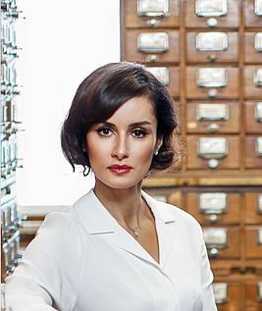


Slide 6
Imagine that you’re taking part in the Brainiest. Answer the questions:
You are in the second round and you have to choose a subject. What subject would you choose? Why?
You are in the third round and you have to answer questions on one famous person in history. Who would you choose? Why?

Slide 7
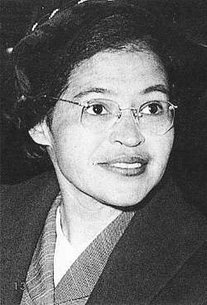
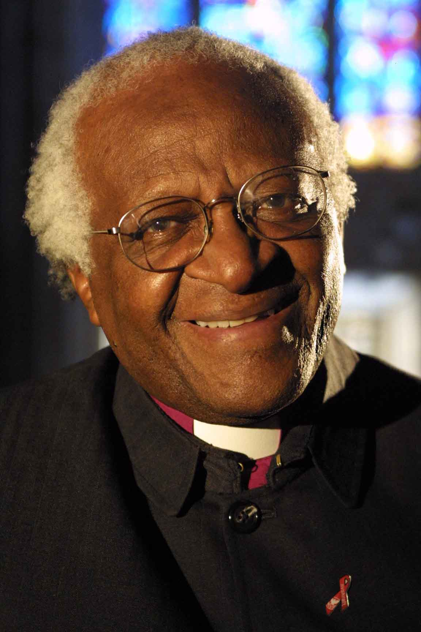
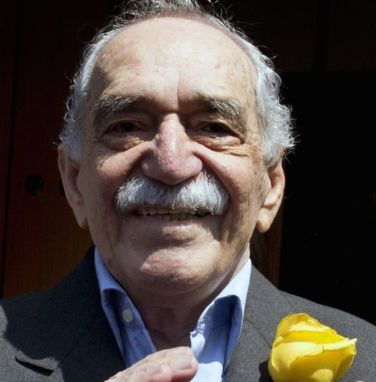
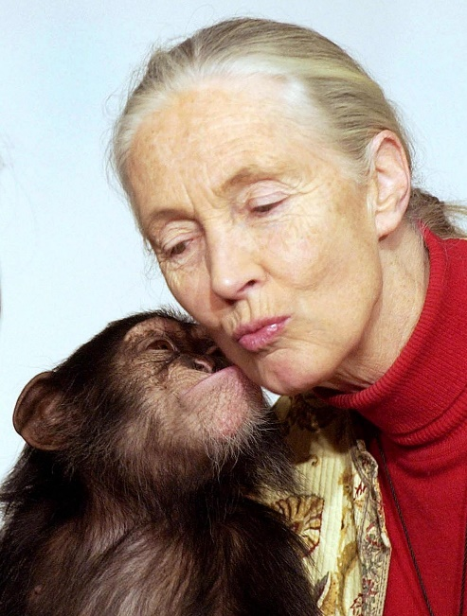
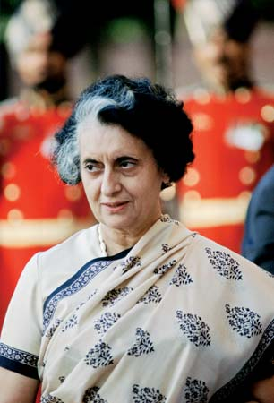
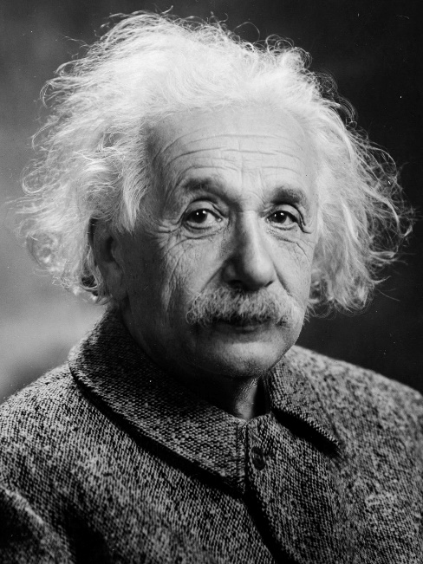
Desmond Tutu
Gabriel Garcia
Marquez
Rosa Parks
Jane Goodall
Indira Gandhi
Albert Einstein

Slide 8
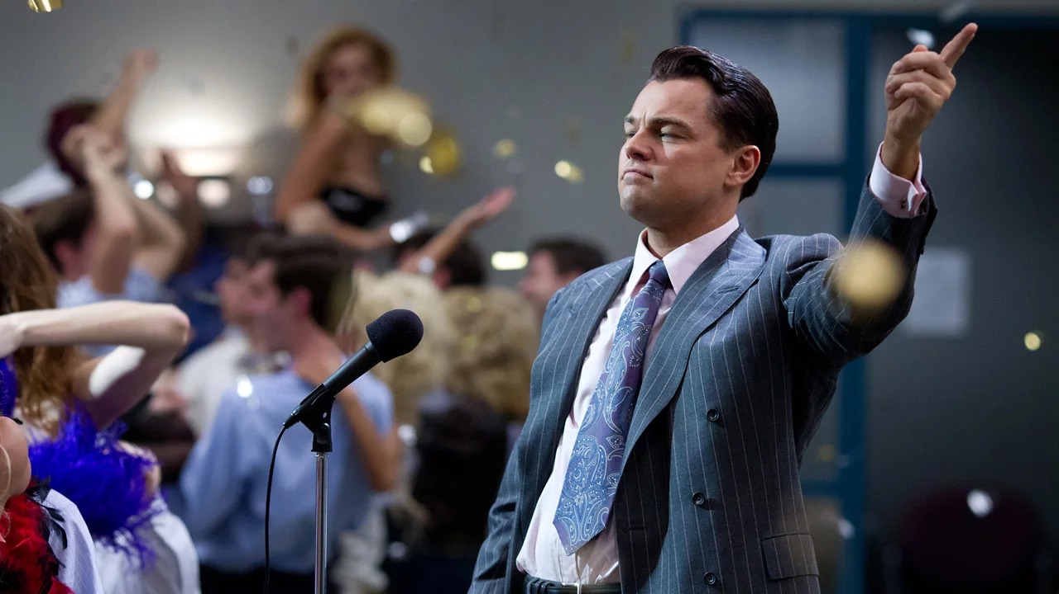

Slide 9


Slide 10
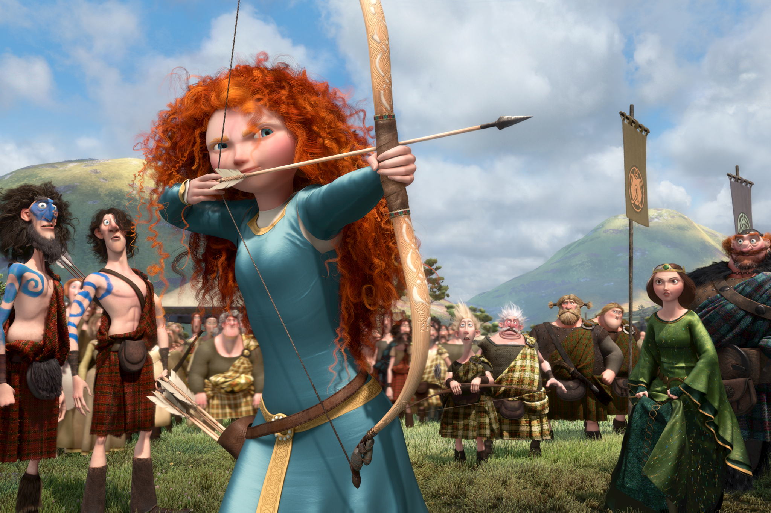

Slide 11
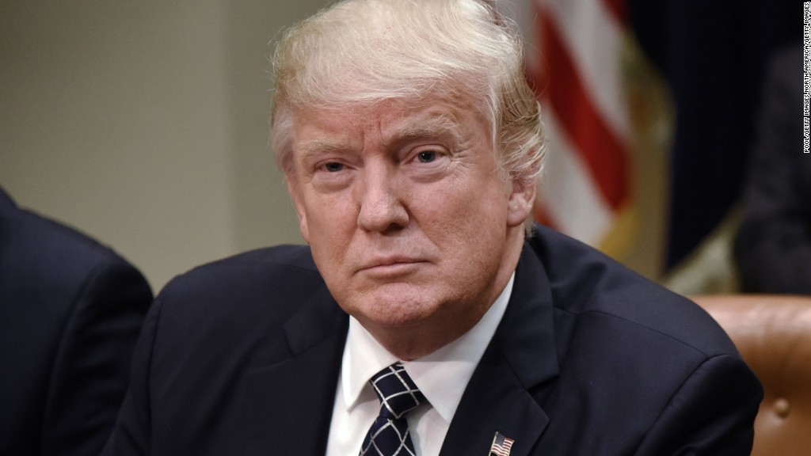

Slide 12


Slide 13
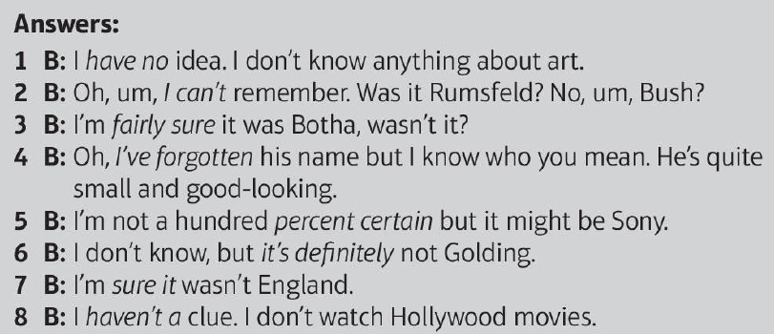
SB: p. 111, ex. 5A

Slide 14
